Slide 1
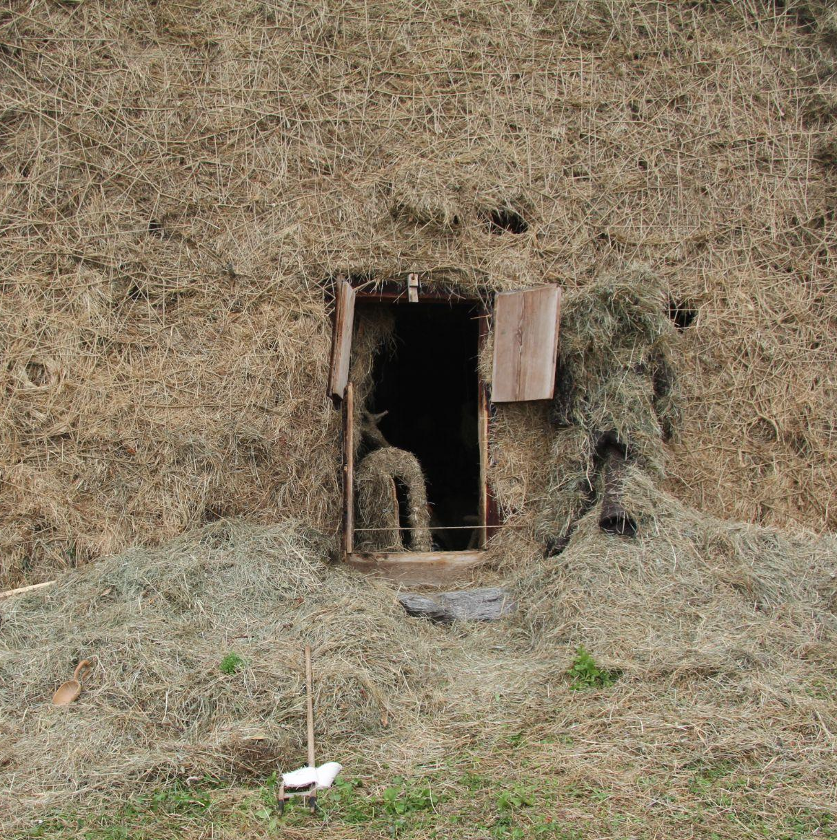
GRASS MUSEUM
The Grass Museum by Dharmendra Prasad was part of the Art Safiental Biennale 2022 and was developed during his stay at the ILEA Residency between June and September 2022.
Artistic director: Johannes M. Hedinger (ILEA, Art Safiental)
Curators: Shazeb Shaikh, Johannes M. Hedinger
Producer: Benedikt Joos (ILEA, Beverin Nature Park)
Collaborators: Gian Pedretti, Olive Lopez, Ditmar Zorn & Olaf Thomsen
Produced by
Institute for Land and Environmental Art (ILEA), Beverin Nature Park and Environmental Art Exchange (EAE) for Art Safiental 2022 with support from the To-gather grant by Pro Helvetia - Swiss Arts Council (New Delhi)
We’re grateful to farmer Josi Messmer for his site, Moss, a 130 year old barn in Tenna that has temporarily transformed into the Grass Museum
Thank you!
Municipality of Safiental, Lena Witschi, Rhea Braunwalder, Bruno Steiner, Sarah Bahr, Akash Sharma, Alex Messmer, Thomas & Tanja Buchli, Sascha Skraban, Jolanda Rechsteiner, Othmar Arnold, Barbara & Stefan Joos, Sebi Nauck, Martin Schaufelberger, Dominik Landwehr, Jeremie Sarbach, Kaspar König, Gita Khandagle, Susanna Pedretti, Piera Vogel, Tara Lasrado, our friends at Versam Kunst Garage, Berghotel Alpenblick & Alps Art Academy
Images by
Dharmendra Prasad, Gita Khandagle, Matthias Kunfermann & Mirja Busch
Grass Museum

Slide 2
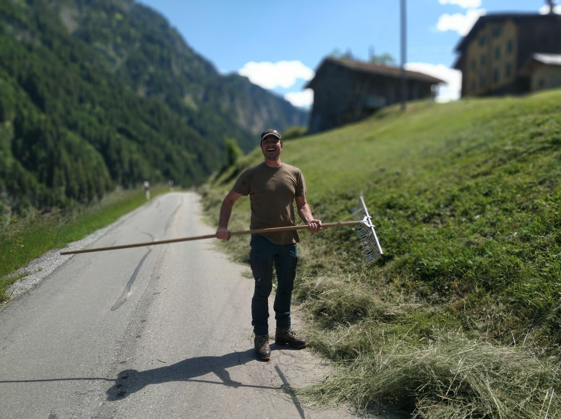
OBSERVATION
Notes from the hay fields of Thomas Buchli (local farmer)
1.
Machines widen the gap between the human body and land.
2.
Grasses smell intense - in the last 20 years there is a shift in the characters and intensity of the smell of these grasses.
3.
Haying is pain, cutting grasses with machines results in the pain in the arms. Pleasure also comes when the work gets done.
4.
How to avoid walking in the cutting process of grass? Thomas is working to build a hay-cutting robot.
5.
When a farmer works under big companies, then a farmer loses his freedom.
6.
Haying is about being alert to the future crisis, biodiversity and beauty of the landscape.

Slide 3
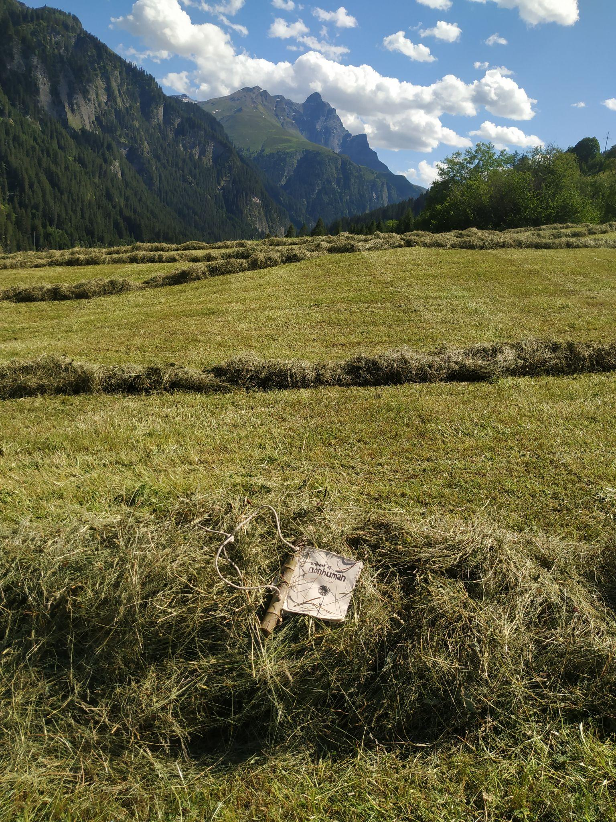
INTERPRETATION
A grass is a book.
A grassland is a library of civilization.
A grass is a personality, who cares and makes life.
I also want to be a grass in future.
My grassness will travel to stones and hide inside the wrinkles of an old man.
My grassness will rest on a flower and gaze stars.
My grassness will navigate a old book to learn how to forget.
- Field notes by Dharmendra Prasad
Notes:
Johannes: if there is a second text, pls add. in his facebook post there a lot of those text. we (he? you?) should collect them all - make a collection, each with date of publishing. this will be be already part of the exhibition
Shazeb: Yes, I will collect all his notes from IG / Fb for the exhibition and publication. My approach to this brochure (vs upcoming project publication) was just to give a taste of things knowing that most people would consume this while being in Tenna (with the QR code, general info) or online. As the upcoming publication will capture a lot of the details with lots of images of the objects, post-musings, the Gian connection, handwritten notes, etc I was thinking of making that the real deal with the details. And leaving the brochure to just touch upon the project. Hence, just a little poem extract for now that contextualises the subject of grass. What do you think? Should we add more poems / text here?
Ok - leave it like it is

Slide 4
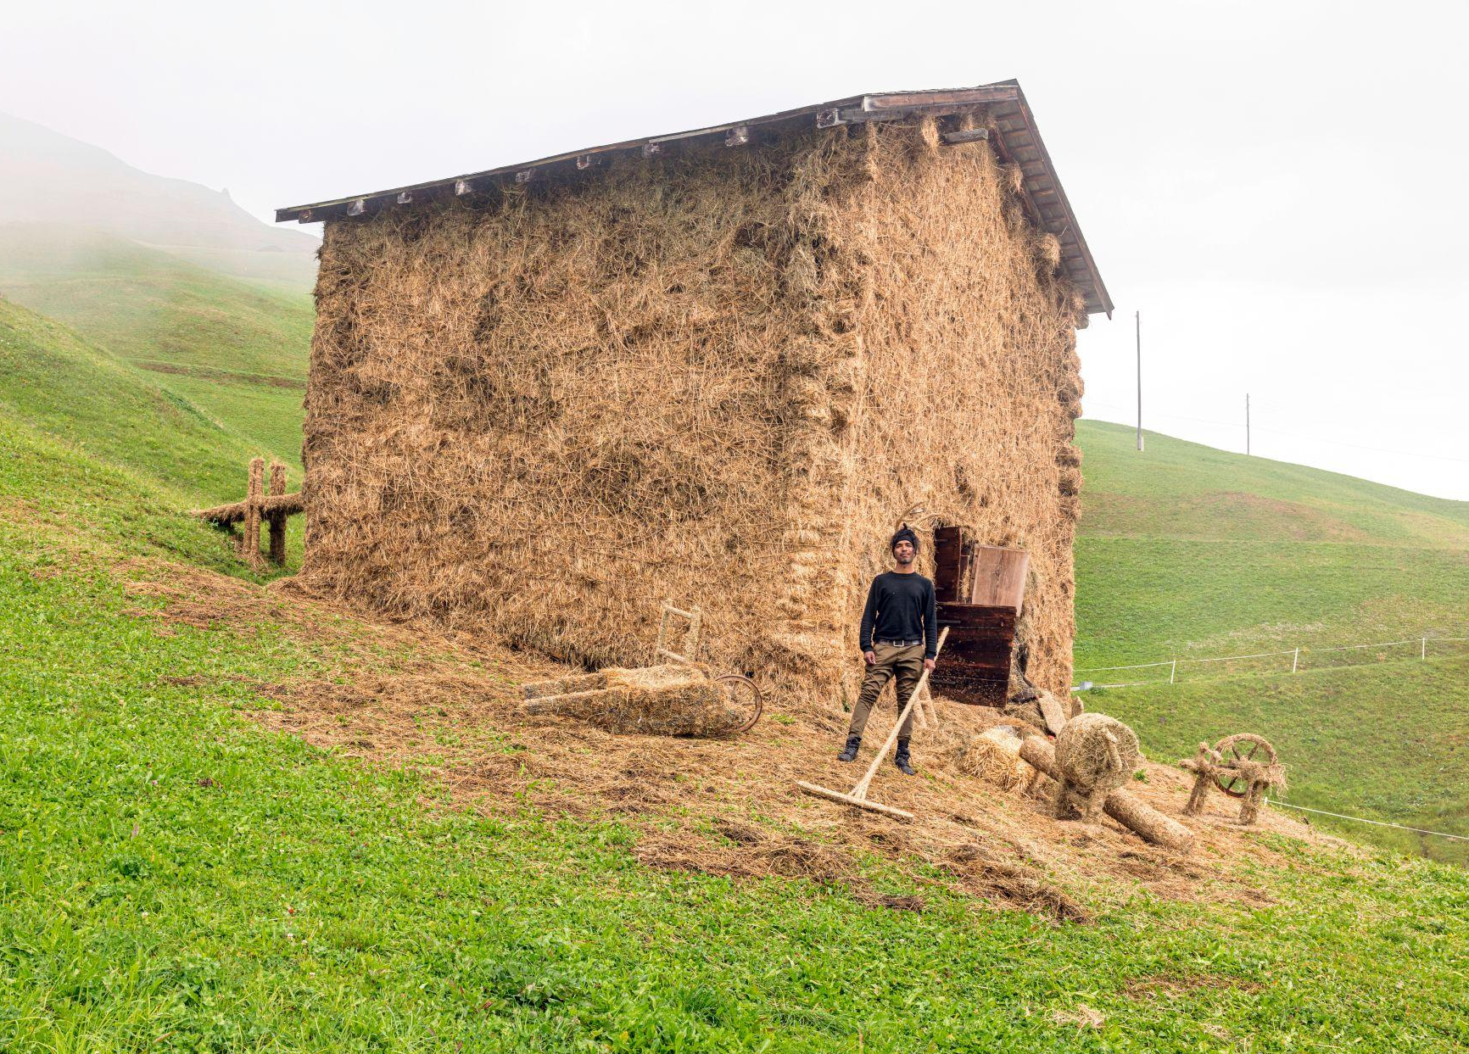
MANIFESTATION
Grass Museum
Established as one of the public works of Art Safiental biennale 2022, the Grass Museum developed into a space that connects the dots of the locals and visitors using grass as the binding thread. For the farmers, every strand is precious, and for the guests it occupies as much visual space as the sky in the Alpine village of Tenna. It’s omnipresent. It’s a lifeline. It tells stories of and to weather. It connects man and animal for both to live a good life. It’s the needed equilibrium for the unique land, environment and people of this valley.
The museum becomes a space for deep thought and slow work exploring grass as a personality and aligning with its non-human position as a tool - to decentralise the human mind in cultural production.

Slide 5
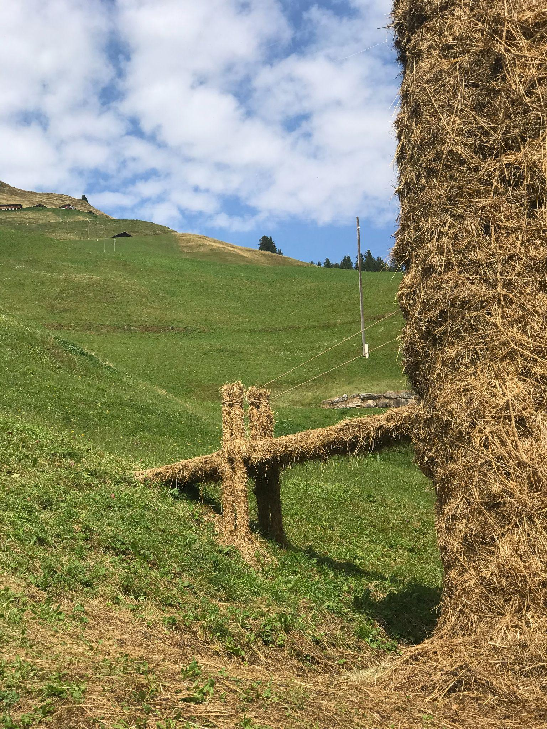
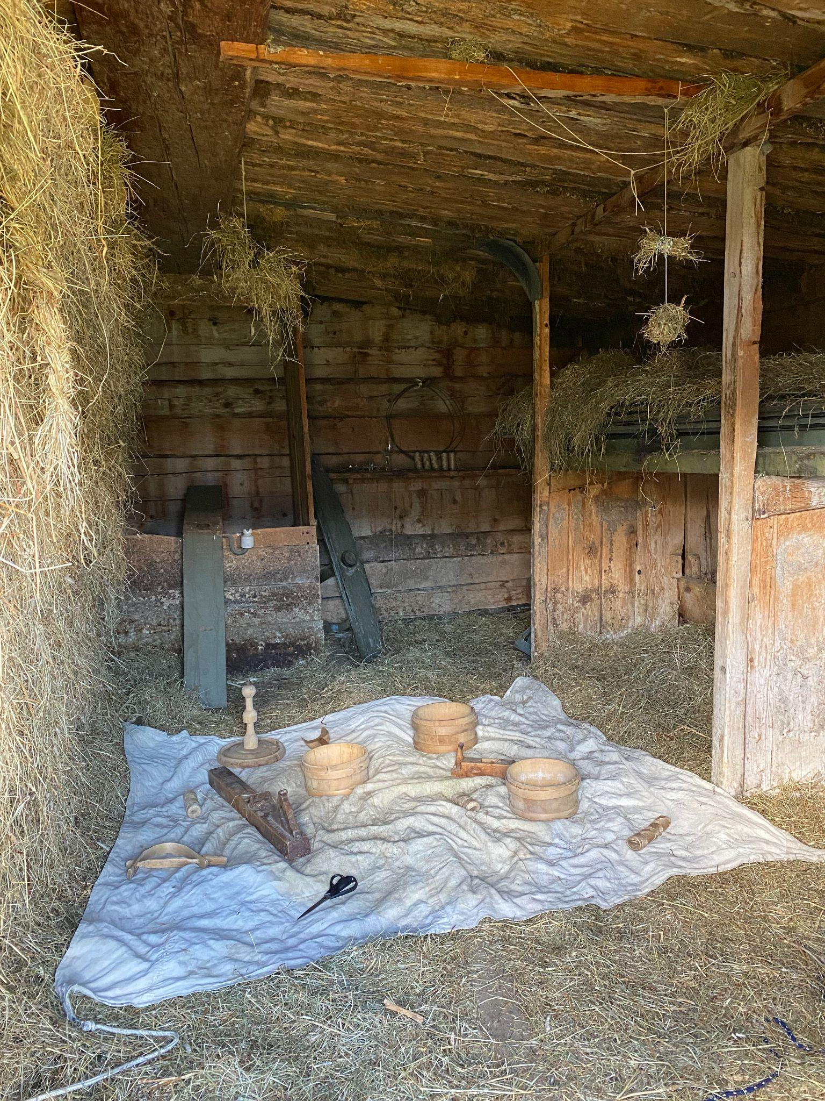
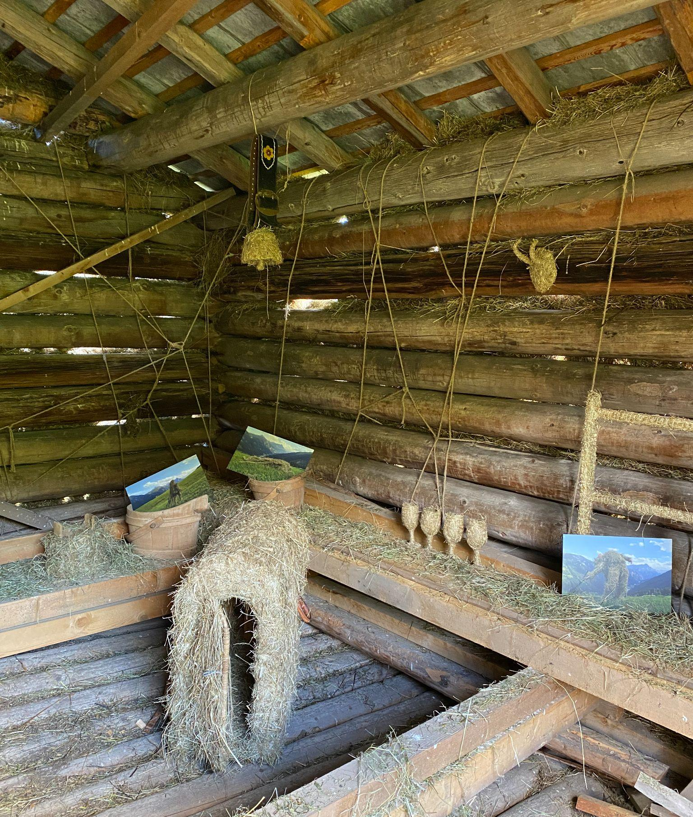
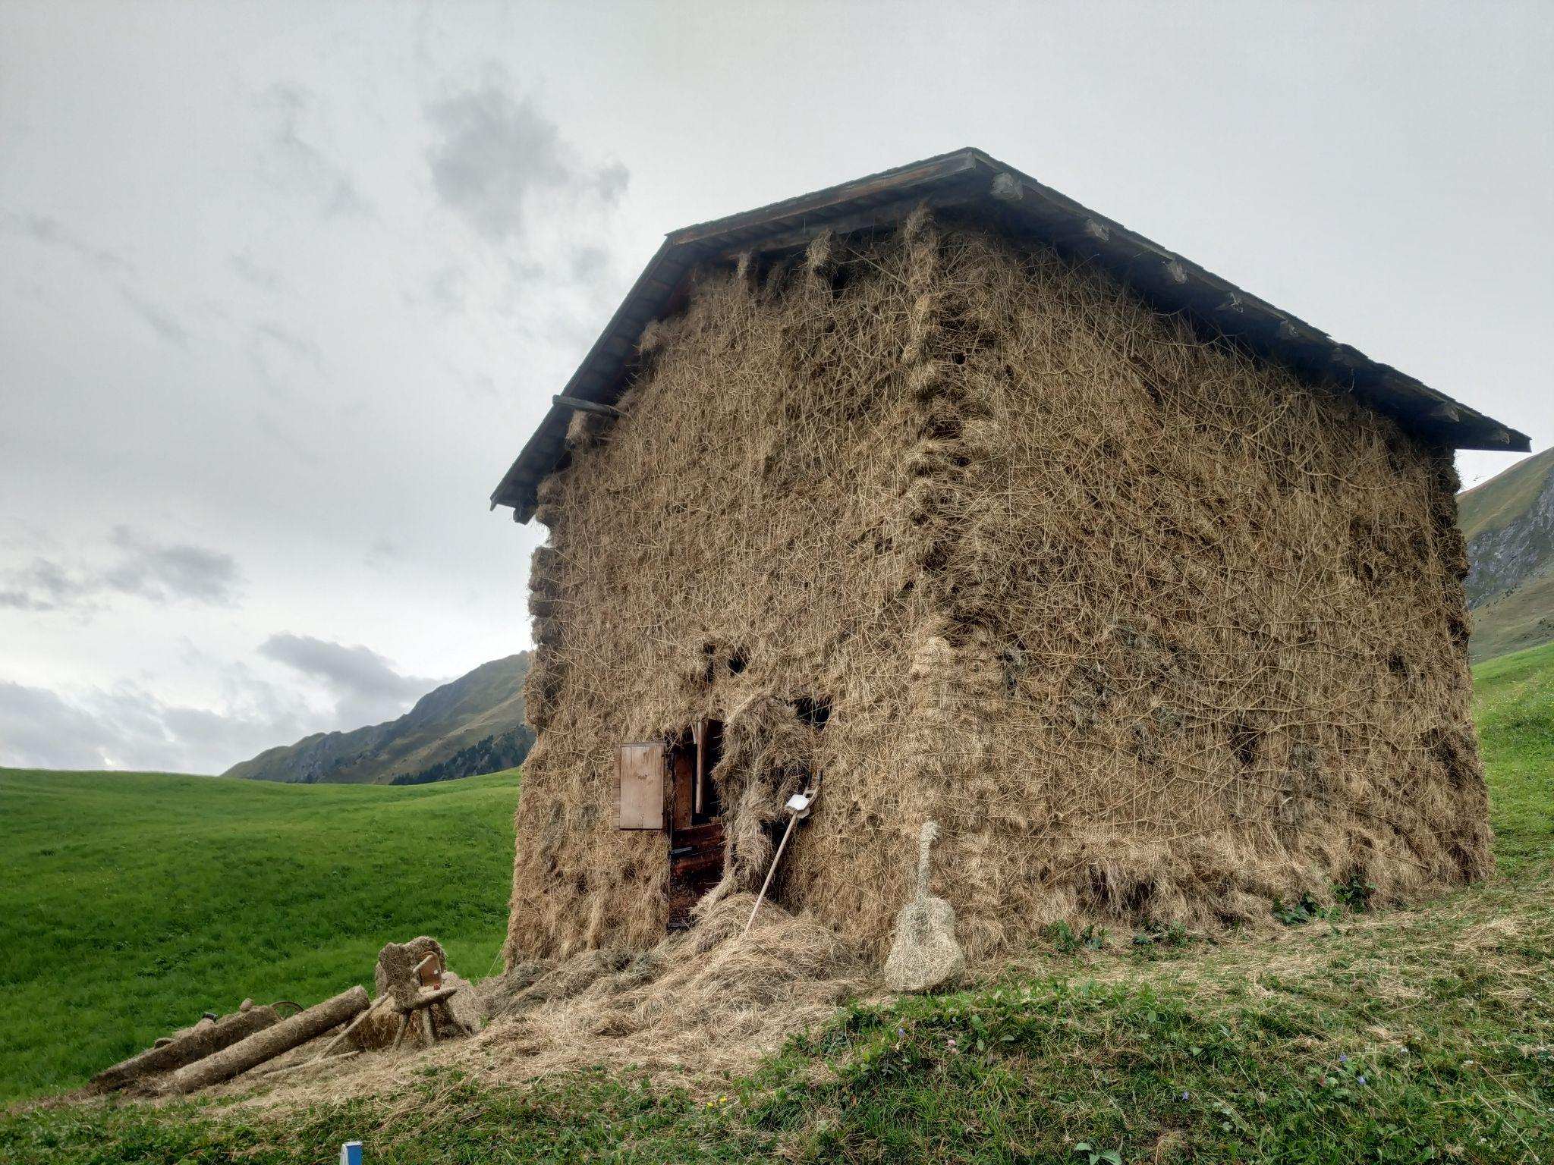
SPACES
OUTSIDE
Facade
The body of the museum is holding a lot together - from the efforts of the many who filled it with grass, to ten thousands of knots that are made with miles of jute ropes. Not a single nail or any adhesive has been used on the original structure. It is a labour of care & community.
INSIDE
Gallery: First floor
The space where all the objects of the growing museum’s collection are on display. Each object carries a story & history of this special slice of the Alps & its agrarian landscape & livelihood.
Audiences could explore the space, its sculptural forms & memories of performances by entering the museum that is itself a sculpture of seasons.
Bridge & open air lounge
The space outside the museum became a hotbed for conversations, a space to hang out & relax. The ‘Joos’ bridge plays its part in creating access & opening up the exhibition space on the first floor besides architecturally extending the span of the museum as a sculpture.
Studio: Ground floor
The space where all the stories, connections & on-field experience of the artist came together to weave the museum and its collection with objects & grass that the artist received from the world around him.
Audiences could contribute to the museum by adding or making your own ‘hayed’ objects in the studio. Objects, needed tools & materials were made available in this working space.

Slide 6
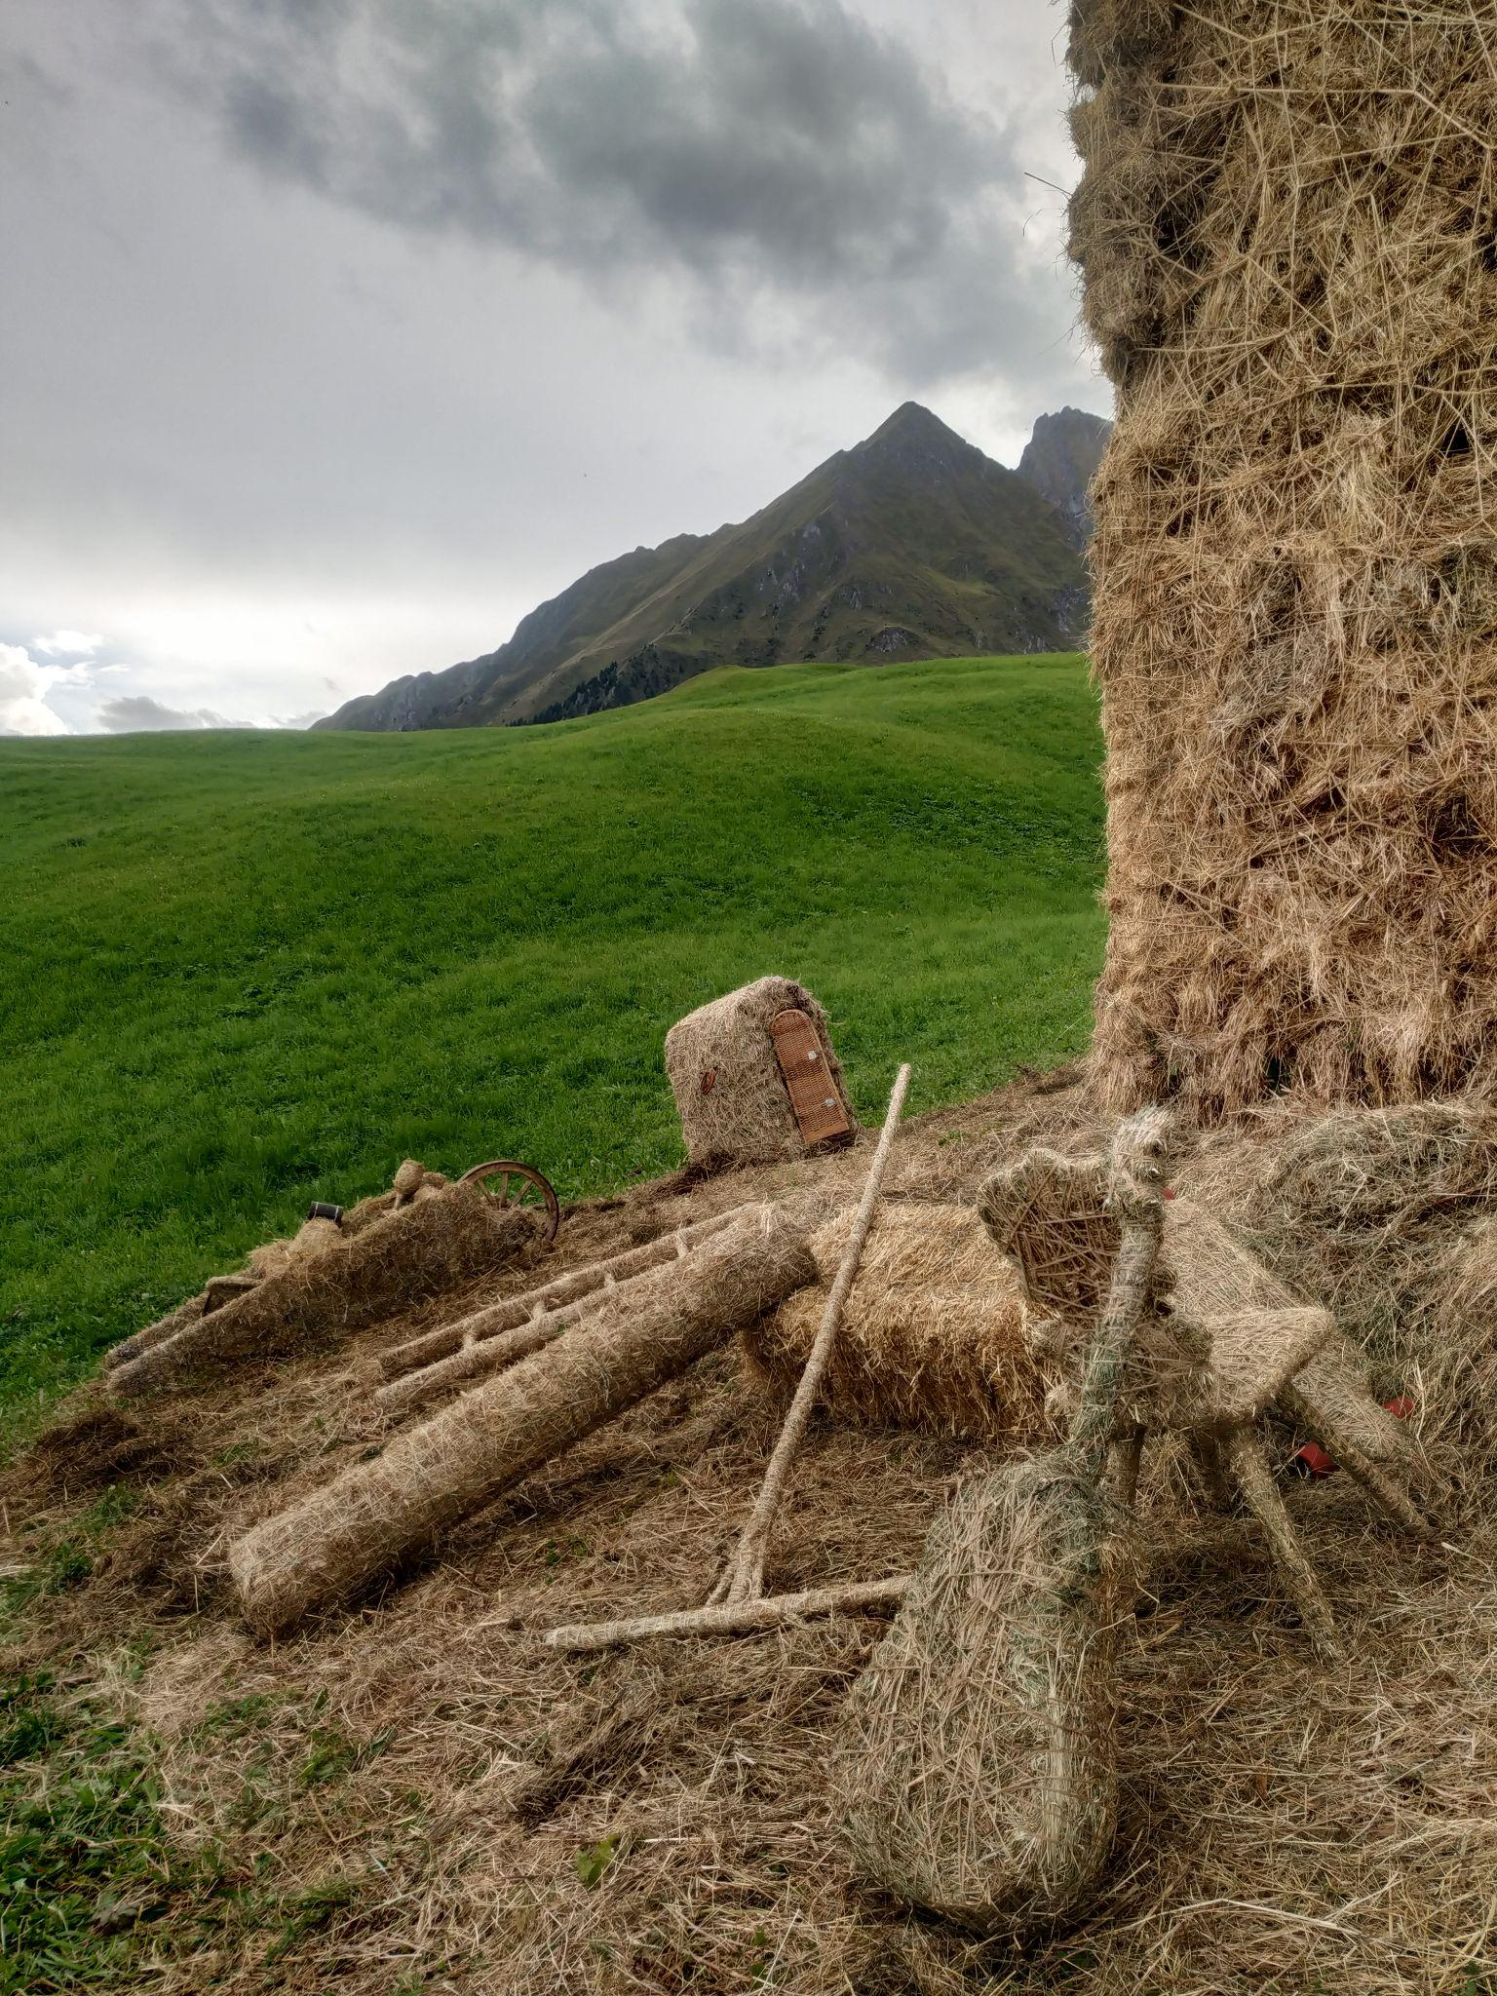
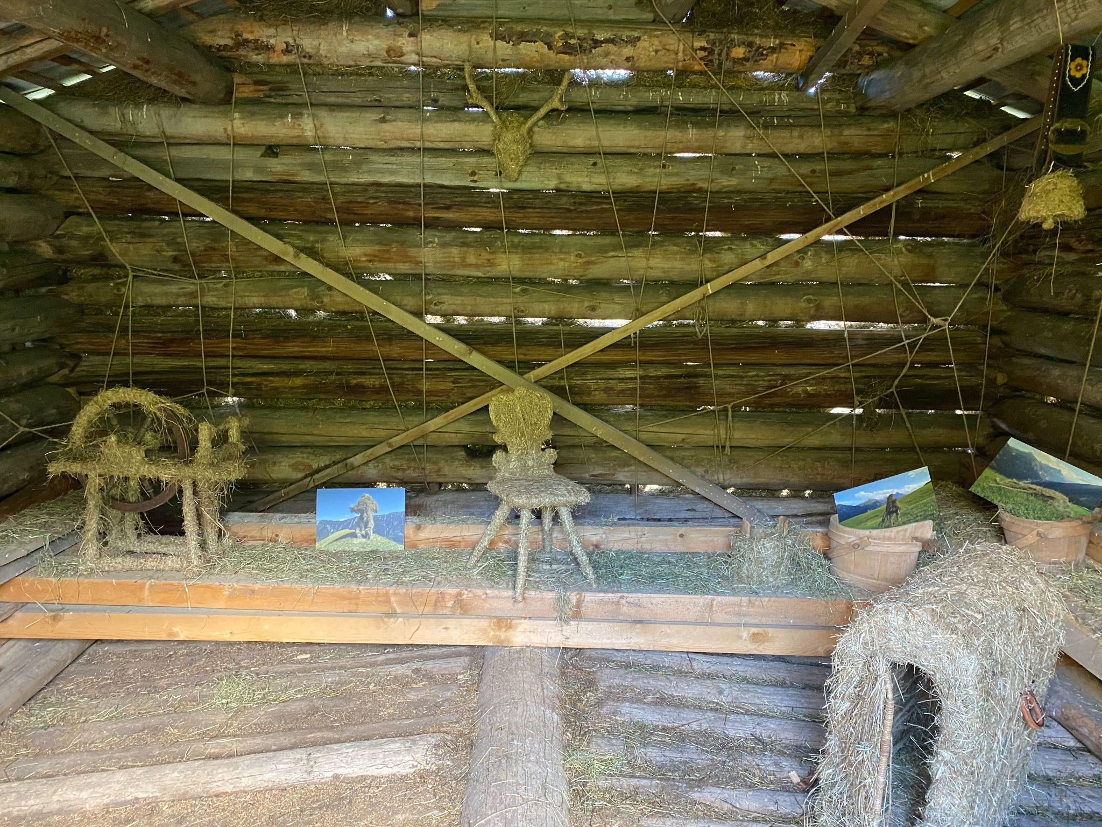
COLLECTION
Grass Museum’s collection consists of several objects, most of which are agrarian tools, or related to the daily life in the Alpine village - both functional and obsolete. Each one has a story of its own, and of its belonging and the time it has lived and seen through before landing into the hands of an artist.
The objects have been carefully layered by the artist with local hay, a big batch of which was living over 30 years in one of the local barns. And one batch from this year’s fresh harvest. Both the binding thread - the grass, and the objects, span generations of local people, knowledge and experiences. The museum is a heirloom of the Alpine families of the Safiental valley but also of the history of the land and its animals - a clue to the revival of the emblematic Capricorn in the Flag of Kanton Grabünden.
As part of the museum’s collection are also impressions from spontaneous live performances and actions that took place during its making.
The complete collection of the Grass Museum objects will be on display in an indoor exhibition at the ILEA Gallery in the Berghotel Alpenblick, Tenna from Dec 2022 - March 2023.

Slide 7
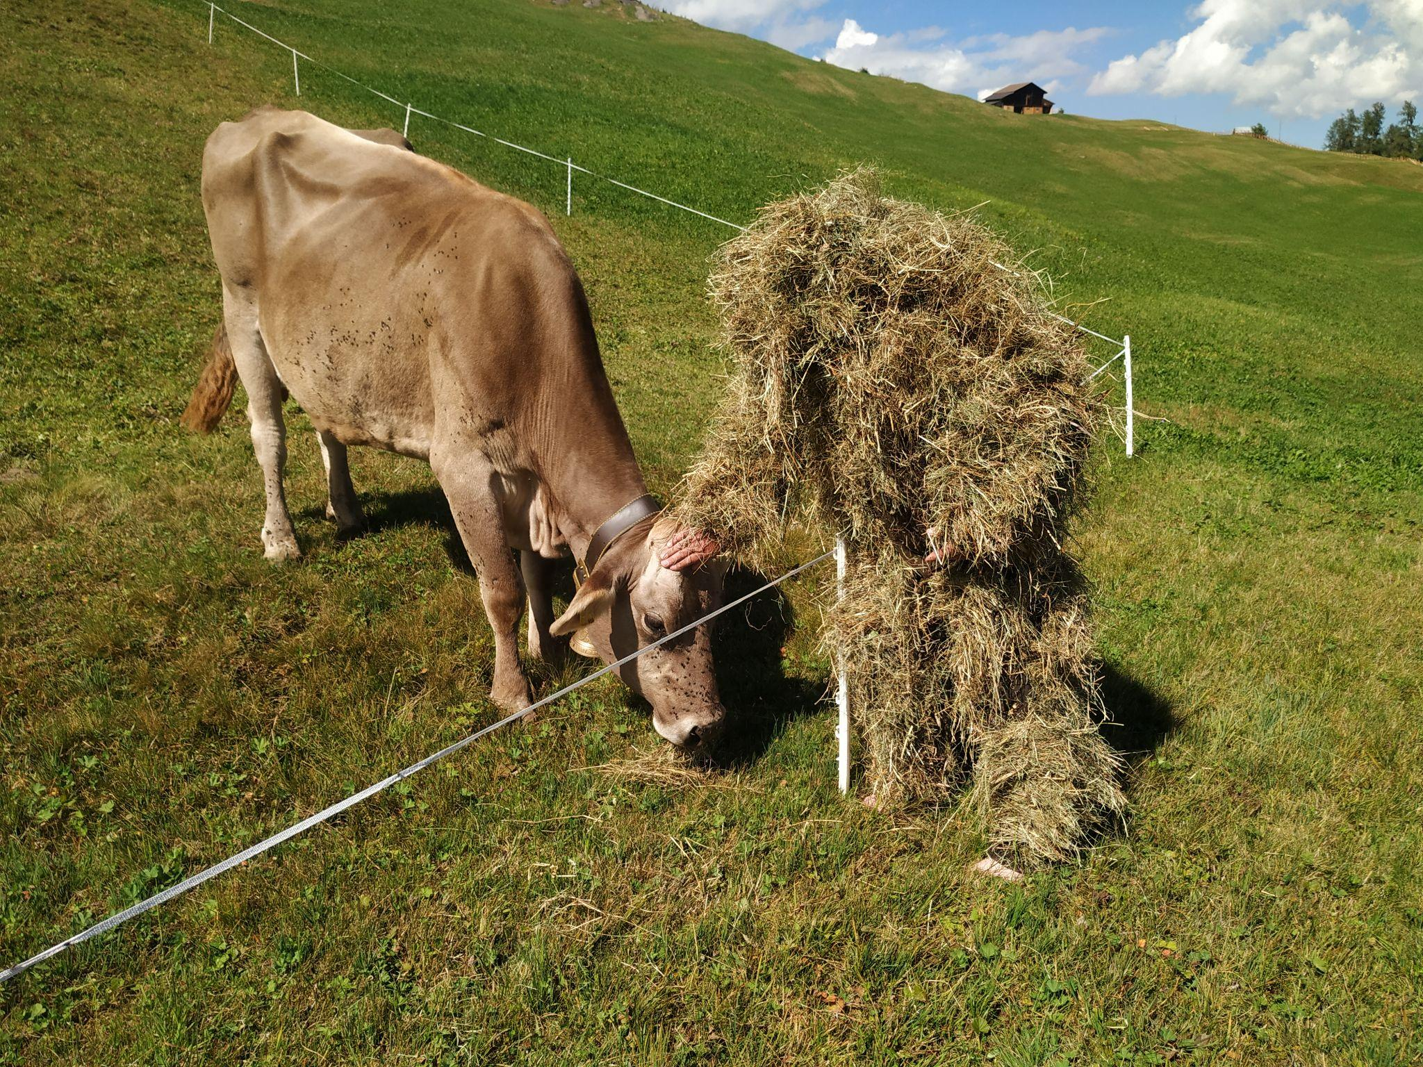
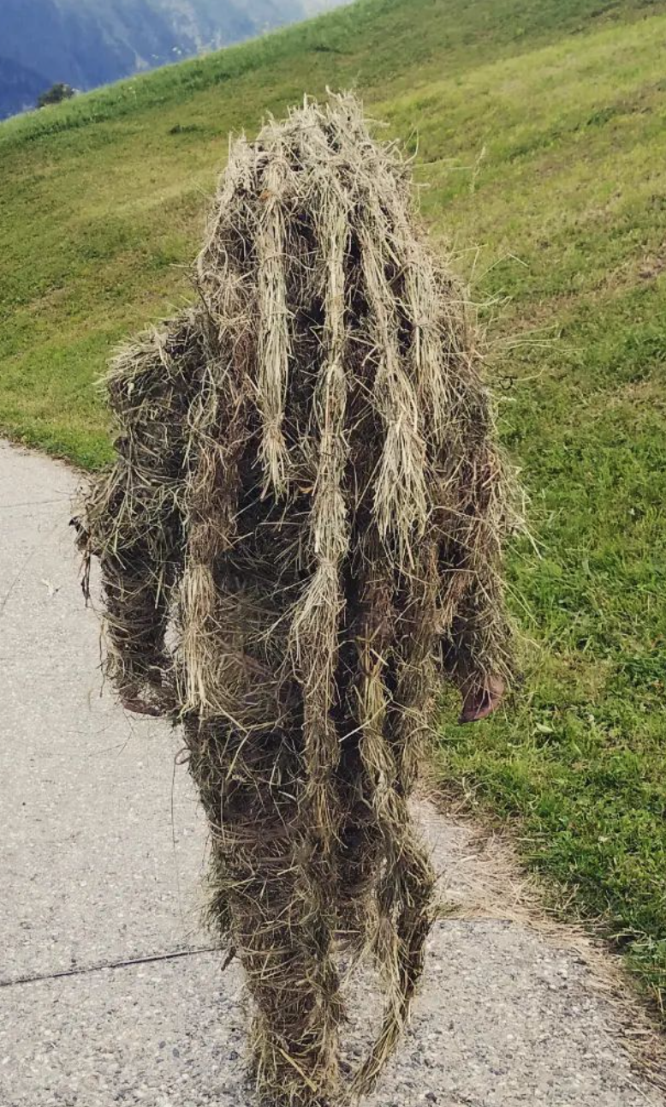
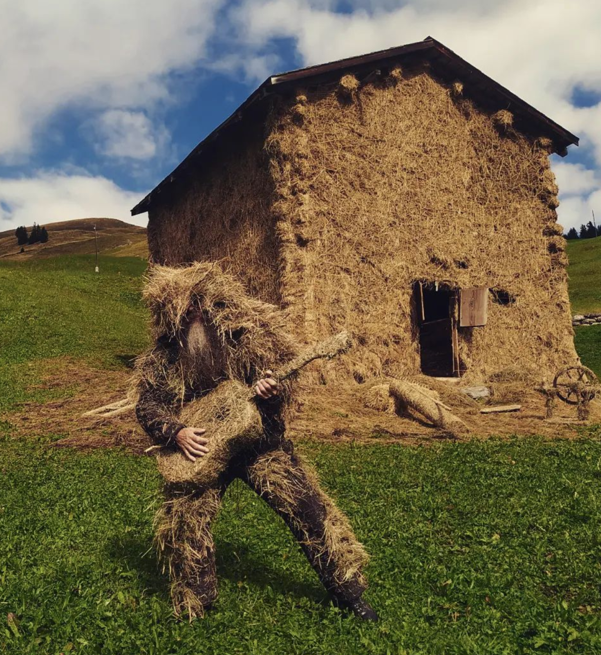
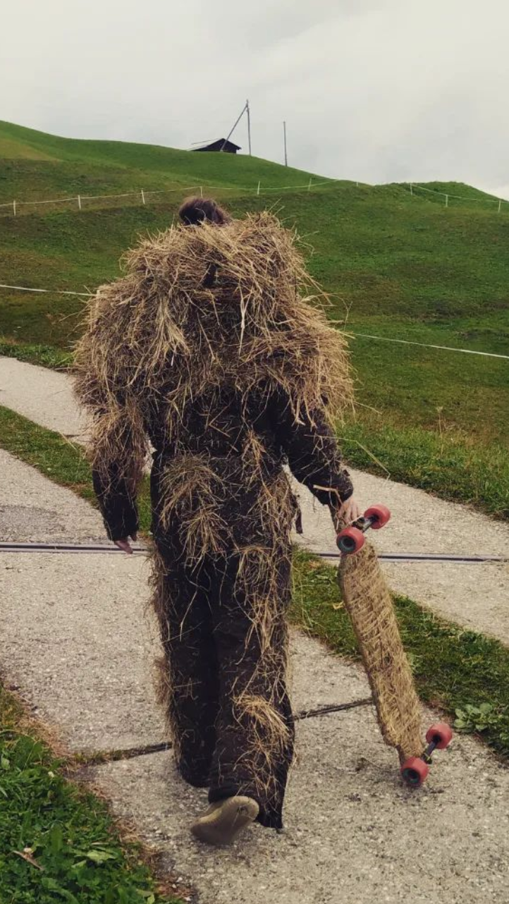
PERFORMANCES
Impressions from live acts for the Grass Museum (Aug - Sept 2022)
Extreme left: Olive Lopez
Centre:
Olaf ‘Hayman’ Thomsen
Top right: Ditmar Zorn
Left:
Benedikt Joos

Slide 8
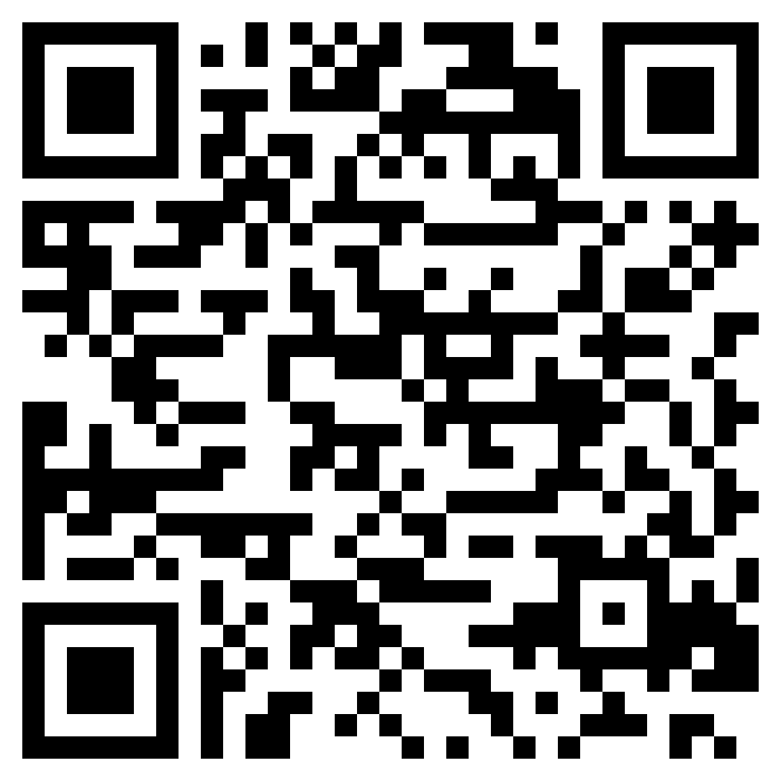
VISIT
Grass Museum
Tenna, Innerberg, Moos-Stall – 15 min walk from Tenna center
GPS: 46.74631, 9.33524
Outdoor facade can be visited until March 2023
www.artsafiental.ch
Grass Museum: Exhibition
Berghotel Alpenblick, Tenna (Mitte)
Opens 27 December 2022
until the end of March 2023

